Slide 1
Effective Communication
BY LECTURER KARANI
Objectives:
Essential Questions:
Identify the components of effective communications
Organize information needed to complete a task
Compare communication skills needed in different health care professions
Develop verbal communication skills
Adapt communication to the needs of the individual.
How does the communication process affect health care delivery?
What are barriers to communication?
How do you adapt communication to the needs of the patient?
What is active listening and why is it important when communicating with the patient?

Slide 2
Communication Pre-Quiz
What 3 things must be present for communication to occur?
Give some examples of barriers to communication,
What is non-verbal communication and give some examples.
What is active listening? Why is it important in health care?

Slide 3
EFFECTIVE COMMUNICATION
Communication
  Verbal/nonverbal exchange of messages, ideas, thoughts, feelings & info
  Verbal: spoken or written word
  Nonverbal: involves body language, tactile stimulation & facial expressions

Slide 4
EFFECTIVE COMMUNICATION
Three things must be present
  Sender: desires to transmit info to another person/group
  Receiver: person or group for whom info is intended
  Message: info that must be transmitted

Slide 5
Barriers to Effective Communication
Barriers to transmitting the message
  Terms patient unable to understand
  Incorrect grammar & punctuation
  Meaningless terms
  Phrasing & emphasis of words
  Tone & pitch of voice
  Speed of speaking
  Use of slang or w/ more than one meaning

Slide 6
Barriers to Effective Communication
Barriers to receiving the message
  Background noise or interruptions
  Ability to read
  Medications
  Age
  Level of education
  Limited English
  Visual, hearing, hearing impairment
  Attitudes & prejudices
  Trust in sender

Slide 7
Understanding the Message
A shared understanding of a message
  – 7% of a message is conveyed by words
  – 38% by the tone of voice
  – 55% by nonverbal behavior
Body language, facial expressions & inappropriate responses may suggest lack of understanding
  Rephrasing message will clarify for receiver
Receivers’ attitude & prejudices may interfere
Utilize active listening: reflective statements & clarification
Maintain eye contact, open mind

Slide 8
Tying Your Shoes Activity Questions
Answer in complete sentences and give details!
What problems did you encounter?
Why is it so hard to give verbal directions only?

Slide 9
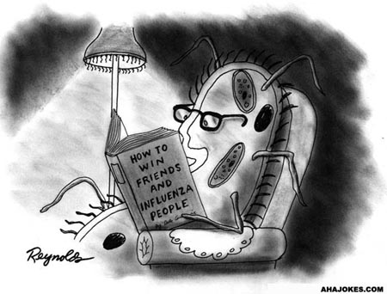

Slide 10
Objectives:
Essential Questions:
Effectively identify the needs of the patient through the use of Maslow’s hierarchy of needs
How needs are met.
Ways to meet the needs of the patient.
How is communication affected when the needs of the patient are not met?
How can you meet the needs of the patient when they are in the hospital?

Slide 11
HUMAN NEEDS
Needs motivate a person to act or behave in certain ways
Needs must be met in order to live fulfilling life

Slide 12
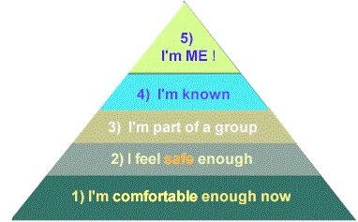
Maslow’s Hierarchy of Needs

Slide 13
Maslow’s Hierarchy of Needs
Physiological (needs of the body)
  Required for life
    Oxygen
    Food
    Water
    Elimination of waste
    Protection from extreme temperature
    Sleep
  Sensory and motor stimulation

Slide 14
Maslow’s Hierarchy of Needs
Safety and Security
  Need to feel secure in environment
  Free from anxiety and fear

Slide 15

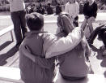
Maslow’s Hierarchy of Needs
Love and Affection
  Need for friendship, social acceptance, love
  Sexuality

Slide 16
Maslow’s Hierarchy of Needs
Esteem
  Feeling important and worthwhile

Slide 17
Maslow’s Hierarchy of Needs
Self-Actualization
  All other needs have been met
  Full potential explored & realized

Slide 18
Meeting The Need
Direct:
  Have realistic goals
  Work hard
  Cooperate with others

Slide 19
Meeting The Need
Indirect:
  Relieves tension/frustration from unmet needs
  Reduces the particular need through defense mechanisms

Slide 20
Defense Mechanisms
Rationalization: using a logical reason or socially acceptable explanation for a behavior that makes a behavior seem appropriate
Projection: attributing one’s own undesirable qualities to another person
Compensation: redirecting of goals
Displacement: redirecting an emotion or behavior from original person or object to another person or object

Slide 21
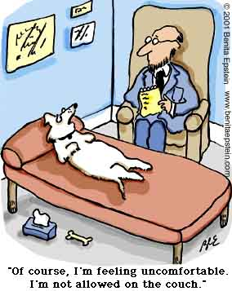

Slide 22
Non-verbal communication
Write a self-reflection on your experience. Include the following:
  Was it difficult? Why?
  Did anyone emerge as a leader? Who and what did they do?

Slide 23
Nonverbal Communication
Objectives:
Essential Questions”
Characteristics of nonverbal communications
How physical behaviors affect communication
How touch is an important means of communication
What are the characteristics of nonverbal communication?
Why is nonverbal communication important in health care?
How does touch affect communication with the patient?

Slide 24
Nonverbal Communication
All messages that are not expressed as words:
  Physical behaviors: any movement of face, hands, feet, trunk, or other body parts that communicate a message
    Facial expressions
    Eye contact
    Posture and gait
    Gestures

Slide 25
Nonverbal Communication
  Vocal behaviors: reinforces the meaning of the message characteristics of voice
    Pitch
    Range of voice
    Volume
    Rate/pace
    Quality

Slide 26
Nonverbal Communication
Space: the amount of distance put between a person and others sends strong messages about thoughts and reactions
  Personal distance: 18” to 4 ft
  Social distance 4-12 ft
  Influences
    Status
    Culture
    Content of interaction
    Gender
    Age

Slide 27
Nonverbal Communication
Touch: one of the most personal & powerful means of communication
  http://www.youtube.com/watch?v=2SpfXZf6bm4
  Essential in healing process
  Kind & amount that is appropriate varies with culture, family background, age, gender
  Meaning of touch depends on type, situation culture and who is doing touching
  Touch avoidance

Slide 28
Nonverbal Communication
Nonverbal message used to accomplish social functions:
  Relationship status
  Emotions
  Enhancing persuasive power
  Achieving understanding
  Regulating conversations
Adds to verbal interactions

Slide 29
Nonverbal Communication
Characteristics of nonverbal communication
  Primary means of expression
  Constantly occurring
  Dependent on context
  More believable than verbal communication

Slide 30
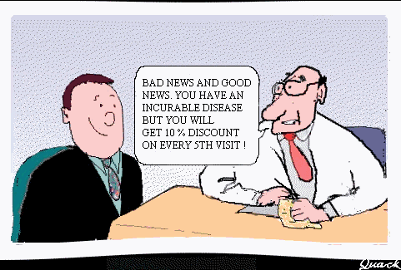
The End

